Slide 1

Setting up a Complete 5G Environment Team_5g_cela_xhelo
Kejdjon Cela Mariglen Xhelo
1439829 1439887
Evaluated by: Prof. Dr.Armin Lehmann

Slide 2
Agenda
Introduction
System and Network of VMs
Simulation Environment
Registration of Users
Start gNB
Start UE
Test Ping google.com
Conclusion

Slide 3
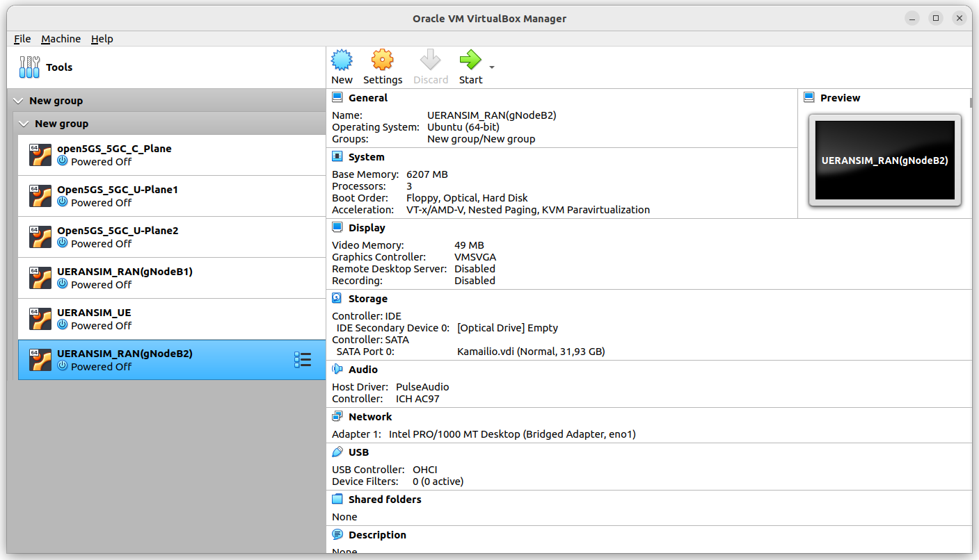
Introduction

Slide 4
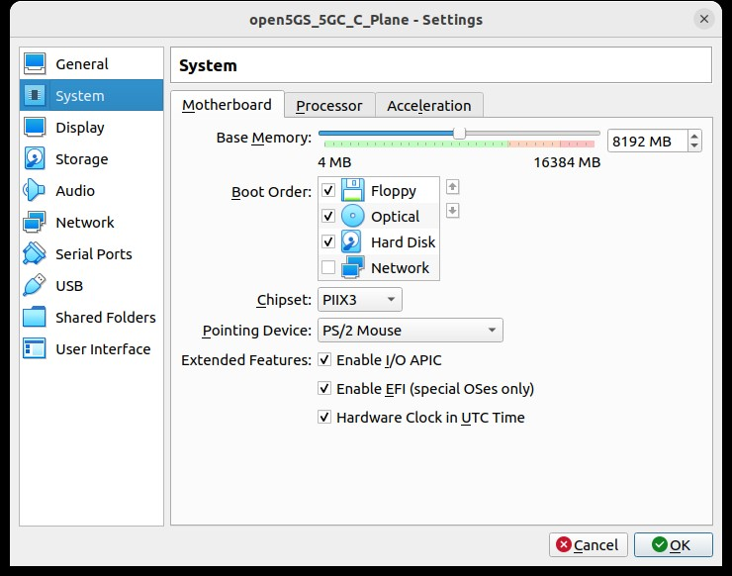
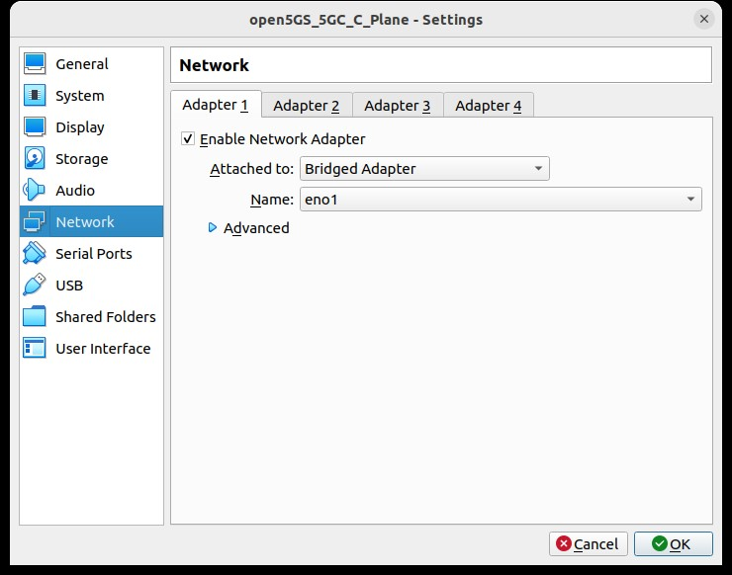
System and Network of VMs

Slide 5
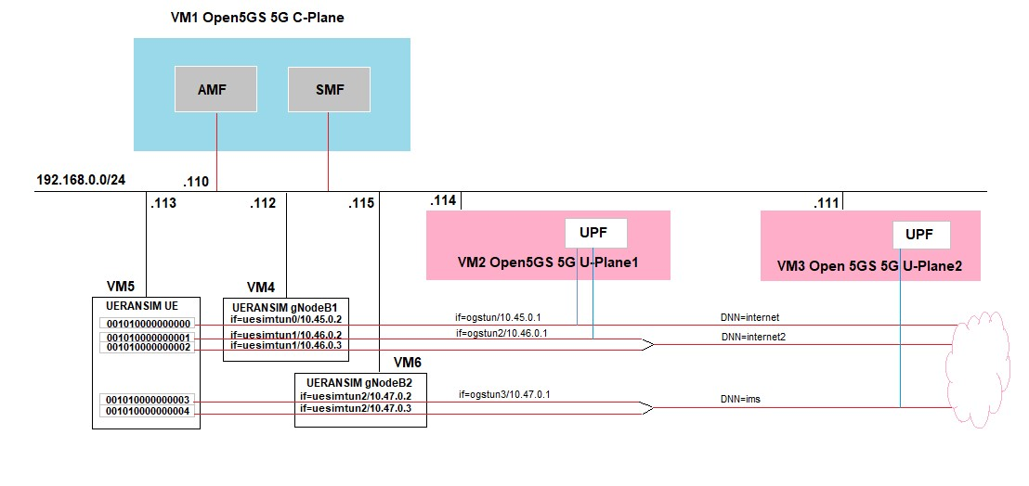
Simulation Environment

Slide 6
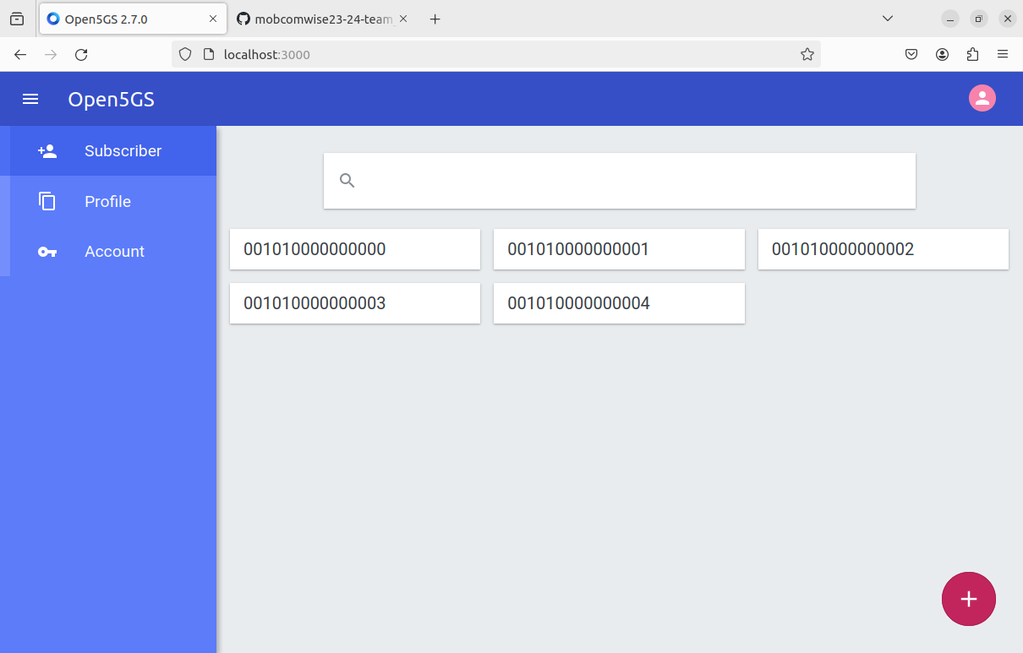
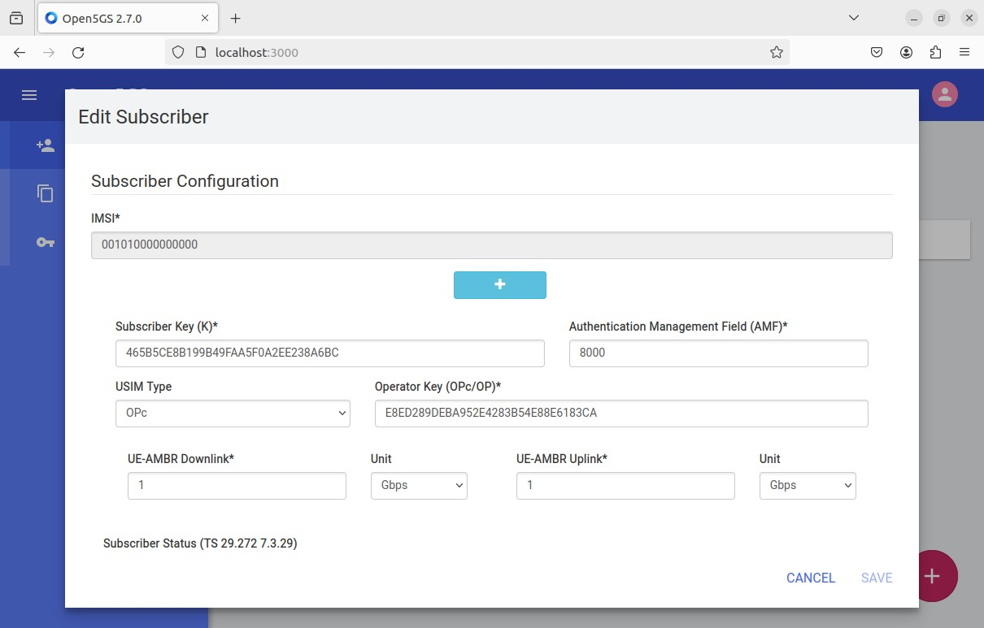
Registration of Users

Slide 7
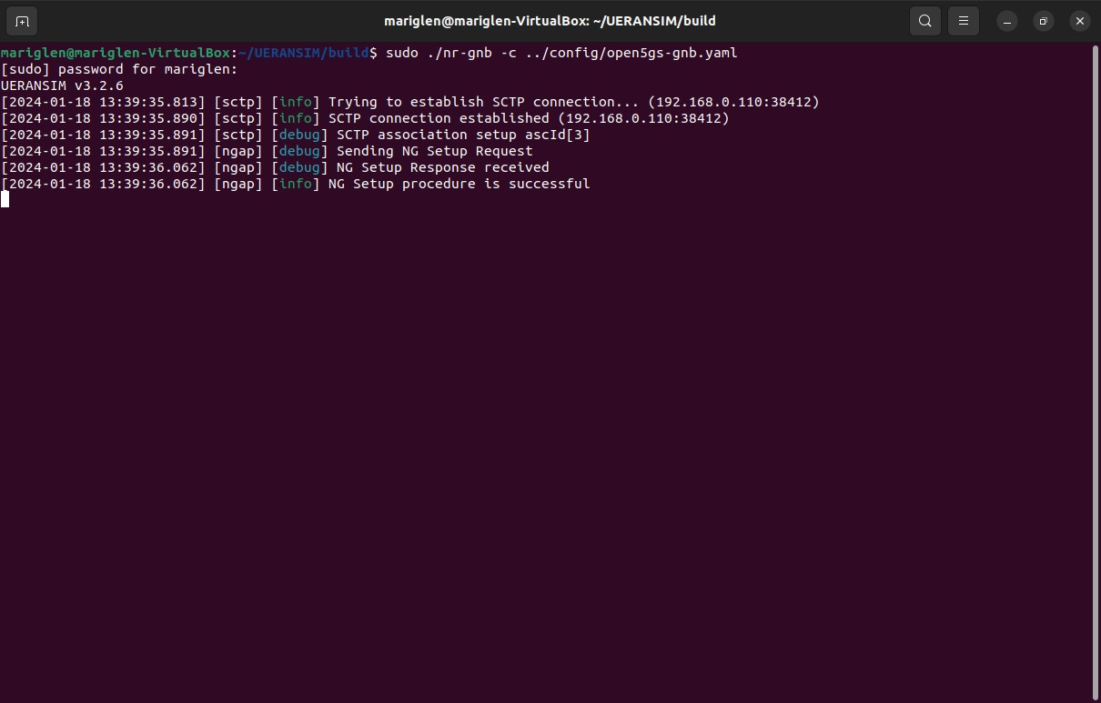
Start gNB

Slide 8
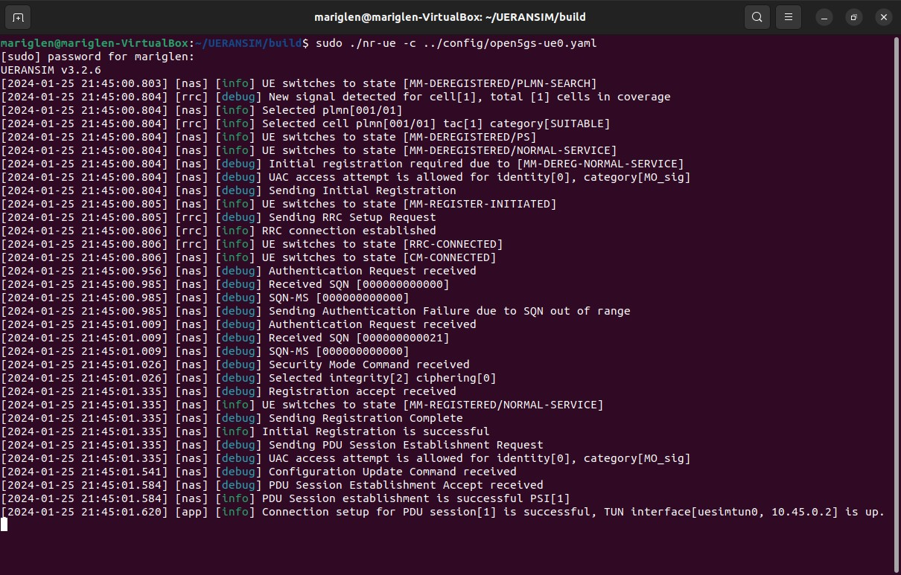
Start UE0

Slide 9
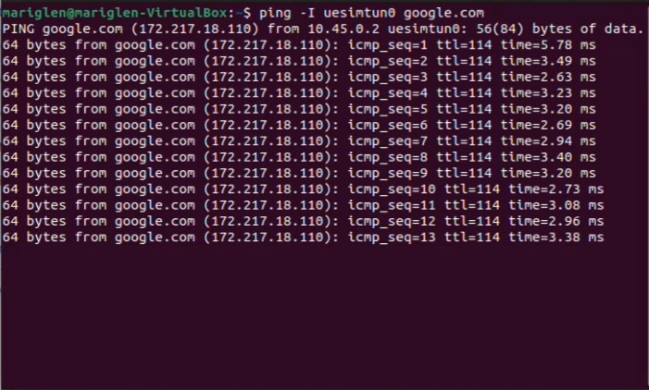
Test Ping google.com

Slide 10
Conclusion
Successful 5G setup environment
Precise configuration and continuous operation
Valuable platform for research and development

Slide 11
Thank You

